Slide 1
Using the PowerSchool Learning Management System
June 2024

Slide 2
To access PowerSchool, go to https://newpaltz.pl.powerschool.com//ia/empari/tab/home
You will be on the landing page, which does NOT include any training information.
To see if you have any outstanding training (e.g., compliance modules that have been assigned to you), select the COURSES tab.
To see what trainings you have completed, select the TRANSCRIPT tab. See image on next screen.

Slide 3
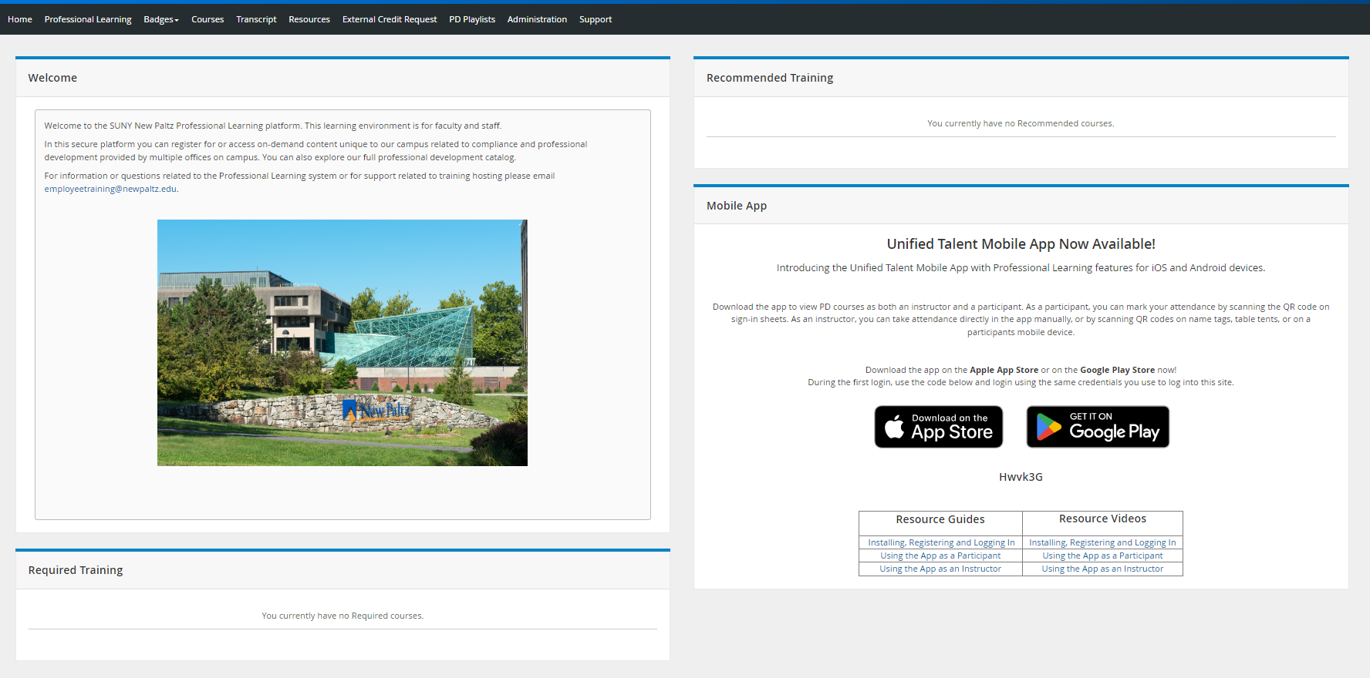
PowerSchool Landing Page
Select the Courses or Transcript tab, as noted on the prior slide.
Ignore this; it does not apply to our training records!

Slide 4
The Courses Tab
On the COURSES tab, on the right side of the screen under “My Courses,” you will see “My Learning Opportunities.” Any outstanding trainings will be listed there.
To access an online module, click on the course name, and then on “View Again.” From the next screen, select “Launch Course” (see next slide).
These are your outstanding courses. Either they’ve been assigned to you, or you’ve registered yourself.

Slide 5
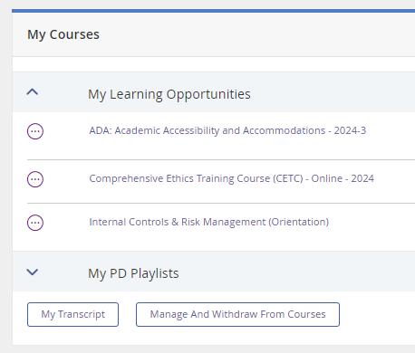
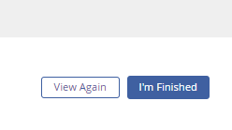
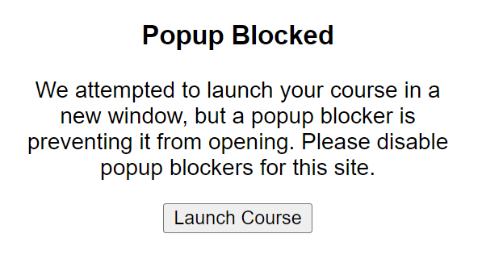
Accessing Online Modules
To access an online module, click directly on the course name.
On the next screens, select “View Again” and “Launch Course.”

Slide 6
IMPORTANT NOTES!
For courses with quizzes (i.e., compliance modules), you must view EVERY slide in the presentation, in addition to passing the quiz, for it to register as Completed (green circle before the course name) and have it show up on your transcript.
It doesn’t matter how long you spend on each slide, so if you read more quickly than the narrator, you can jump to the next slide.
For most courses you will receive an emailed copy of your course quiz. You should retain it in case we need it to verify that you’ve passed.
It may take as much as 48 hours for the system to reflect your course completion.
All of your completed trainings are in your Transcript. See next slide for more information.

Slide 7
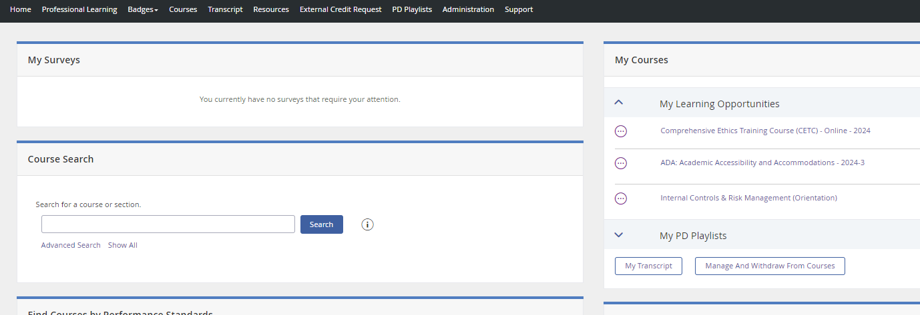
Transcript
Your training history is recorded on your Transcript. There are two ways to access your Transcript:
Select the TRANSCRIPT tab at the top of the screen
From the COURSES tab, you’ll see a link to “My Transcript” underneath the course names.
1
2

Slide 8
Compliance Training for 2024
ALL employees must complete the following:
Comprehensive Ethics Training Course (CETC):
We are offering classroom-based and remote sessions, in addition to the remote sessions presented by the Ethics Office in Albany. All options are advertised via email and in The Digest.
There will be an online module available by the fall semester. (The module we were provided with is not accessible, so we are working on adding voiceovers. We will announce when it is available.)
Employees are expected to register themselves for this training.
Title VI Training:
This was presented as a Webinar by Albany; most employees viewed the webinar.
A recording of the webinar is posted on Brightspace (the format does not work on PowerSchool). Anyone who was unable to participate in the live presentation can fulfill the training requirement by viewing the module on Brightspace.
We will present the recording in a classroom later in the year, for those who are unable to view it online or who prefer to view it in person.
Title IX:
The law has been significantly changed and we will launch a revised online module in spring of 2025. We will assign the revised module to all new hires in the fall.
Workplace Violence Prevention
We made some modifications to the training module. Due to the delay in revising the training, we are only assigning it to new hires in 2024. All employees will be assigned this training in 2025.
Clery Act:
All UUP-represented employees must complete this training annually. It is posted on Brightspace due to formatting incompatibility with PowerSchool.
ADA (Americans with Disabilities Act)
This has been assigned to all those who interact with students, including all teaching faculty and those employees working in student support areas.
This module is hosted on PowerSchool and will show up under the “Courses” tab.

